Slide 1
Discovery ‘Trust’
By QWERTY
Team Leader: Sarah Ingram
Daniel Bockle
Sean Morrison
Jean Marx
Notes:
Introductions:
Sarah – UI development, database design, integration of backend to front end
Daniel – Data cleaning, forecasting model, , integration of backend to front end
Sean – Fundamental financial data scraping, cluster analysis, machine learning models
Jean – Machine learning models

Slide 2

What was the South African issue we wanted to solve
Notes:
Discovery is about making peoples lives better, our platform is about making your users financially healthy.
In South Africa, most people do not have access to timely financial advice. Often it is the very people that need this advice the most that do not have access to it.
Our platform was designed to bridge the gap between financial advice and the everyday South African from the comfort of your own home.
We want to pave the way to financial health in the future by helping South Africans invest today.
We completed a data analysis block and we all really enjoyed it. Combining that fact with a burning curiosity and a desire to help South Africans, we developed this idea

Slide 3
What did we do?
Data acquisition, cleaning and pre-processing
Exploratory data analysis
Web framework
Forecasting models
Machine learning models
Database design and implementation
Notes:
Daniel
We created three models that allow us to give the users a selection of shares that they can purchase based on their risk appetite.
Two of these models classify the shares of companies that are listed on the S&P500. They were categorised into three risk categories – High, Medium, and Low.
The first model is a AI model built using technical data – the open, close, high and low price for each day.
The second model was built using fundamental data – specifically a number of the ratios that were chosen due to their significance when applied to the risk of a share.
The last model is the one that predicts the share price of the shares – this was done using technical statistical data.
We have also built a UI using R and linked it to a Postgresql database.

Slide 4
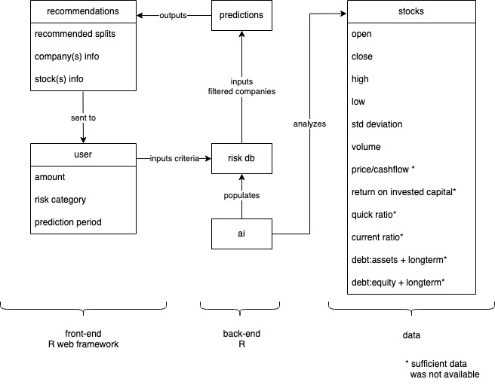
Dataflow
Notes:
Jean walkthrough of dataflow

Slide 5

How did we do it?
Phase 1
Data acquisition, cleaning and preprocessing
Risk classification
Phase 2:
Forecasting
Supervised machine learning for risk classification
UI and Database Development
Phase 3:
Integration of front end and back end
Notes:
Sean talks about web scraping data
Daniel, Jean and Sean talk about calculating volatility using std deviation, cluster analysis,
Daniel talks about forecasting, GARCH, limitations – shorter prediction period is more accurate
Jean talks about ML – knn and repeated cross fold validation, trained on 500,000 observations, 99% accuracy
Sarah talks about the web framework
Everyone talks about integration

Slide 6
Changes from proposed plan
Company sentiment analysis
Lack of data for comprehensive fundamental analysis
Portfolio-based suggestions
Switch from cloud computing to local
Notes:
Sean
Company sentiment analysis: Initial models showed that the analysis had very poor accuracy when making predictions
Lack of data for comprehensive fundamental analysis: Have a model but it is very limited due to lack of data – with access to a database of fundamental data we could produce a weighted risk classification
Portfolio-based suggestions: This a planned feature, however, for the purposes of this demonstration we have made use of a single share suggestion to she the core functionality of the platform.
Cloud to local: Could not set up cloud computing, so we brought in additional hardware to increase our computing power

Slide 7
Future of Discovery ‘Trust’
Weighted risk model
Weighted forecast model
Current data
Portfolios
Integration with Discovery Points
Advanced User input and output
Cloud based
Notes:
Jean
Sean and Daniel – mention fundamental data, such as ratios instead of high low, close etc
Sean
Sarah
Sarah
Daniel
Jean

Slide 8
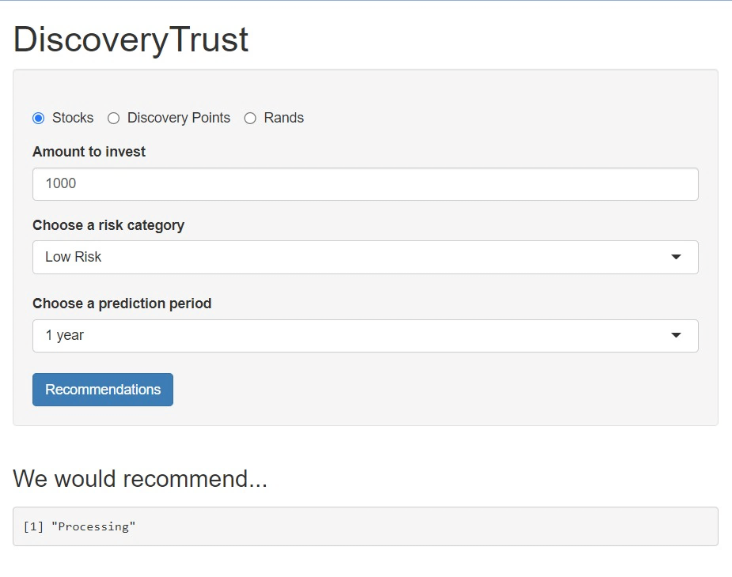
Proof of concept
(user interface)

Slide 9
Questions?
https://github.com/Jeaninjeanz/qwerty2023

